Slide 1
Unit6 Keeping Fit
Period3 Reading Part
Xiangyin No.1 Vocational School
Wang Chao

Slide 2
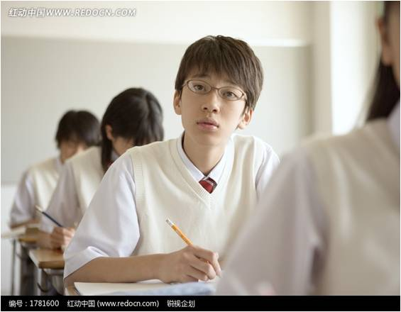
Ⅰ.Lead-in
1.What’s she doing？
2.Do you think she is healthy？
She is making a smoothie for breakfast.
The breakfast is very nutritious including vegetables and fruits.

Slide 3

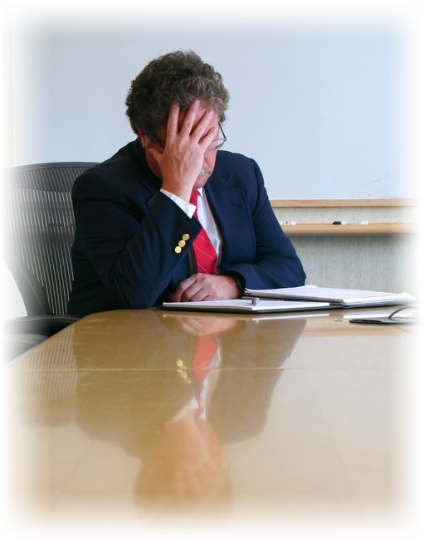
Ⅱ.Reading
A Health Star
Two years ago, I got a good job. I spent long hours sitting at a desk and operating the computer all day. I drove to work and never did exercise. I began to smoke, because I felt too tired. I felt relaxed when I smoked. But I had to stay up late and couldn’t sleep well. Gradually, I had no appetite and became weaker and weaker.
Six months ago, I changed my job.
Luckily my new company offers ideas on
healthy life, which encourages all employees
to do more exercise and keep healthy. Our
manager thinks a healthy person can always
achieve what he hopes for in his career. So I
begin to carry out my fitness plan.
Question：What does the auther think of health？
What’s his advice？

Slide 4
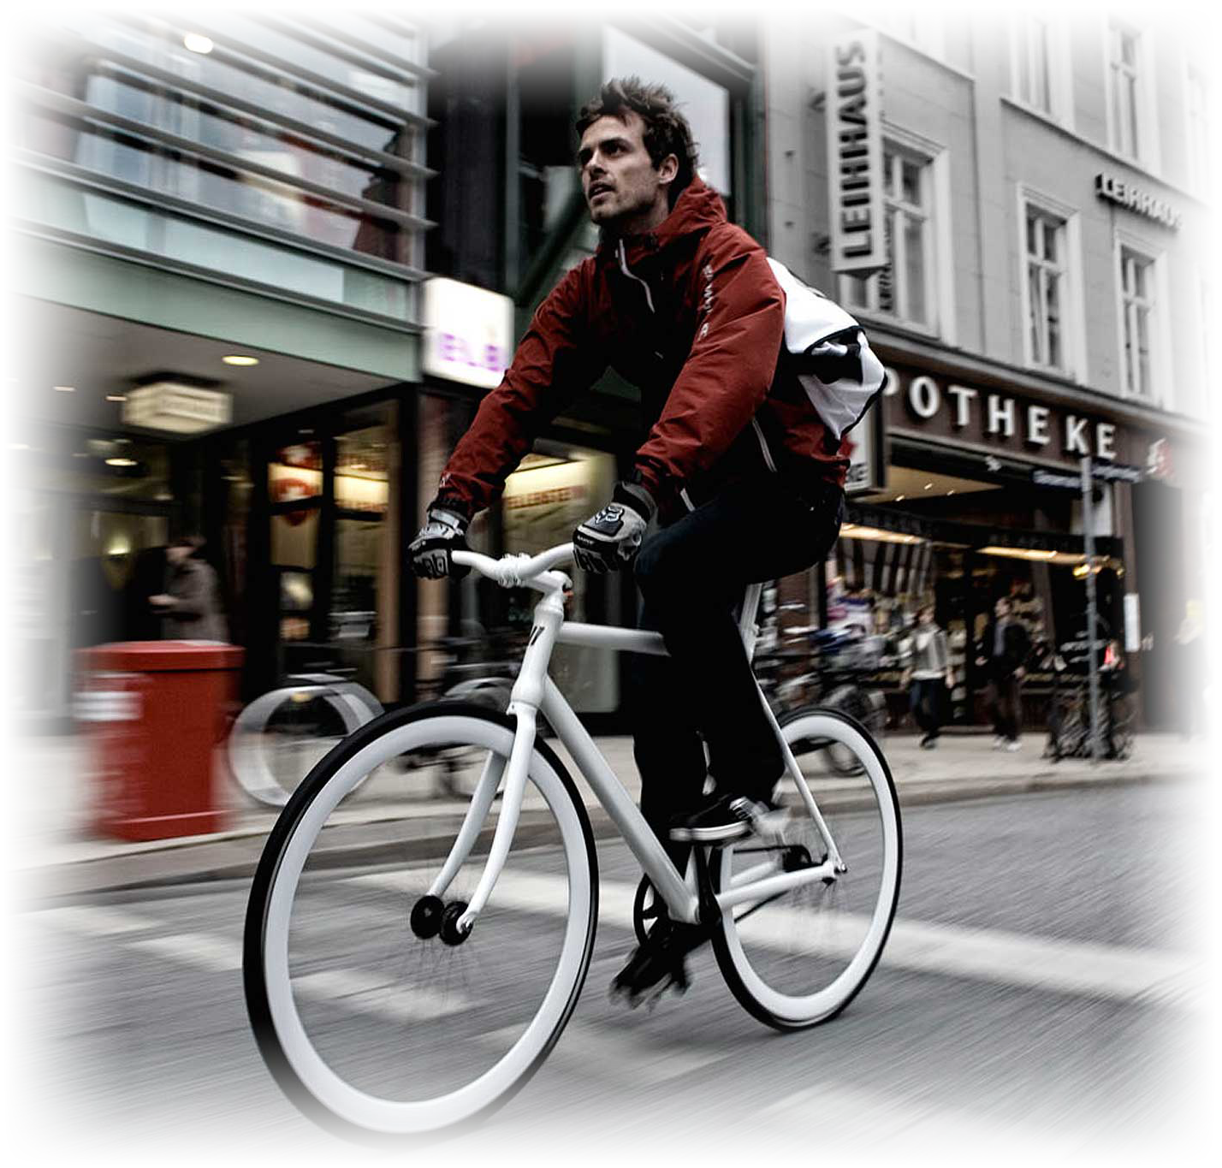
Question：What does the auther think of health？
What’s his advice？
Every morning I get up early and do exercise outside. I cycle to work. The most important thing is that I have given up smoking. I eat more vegetables and fruit. Now, I can eat well, sleep well and have a lot of time to do the things I enjoy doing. To my joy, my
colleagues selected me as a “health
star” of our company last month.
In my opinion, nothing is more
valuable than health. Trying every means
to keep fit is my advice to the people
who want to live a happy life in this
beautiful world.

Slide 5


Ⅲ. Read and answer.
1
What did he use to do? ________________________
A. Spending long hours sitting at a desk.
B. Playing online games all day.
C. Riding to work.
D. Doing exercise too often.
2
Why did he smoke? ____________________________
A. Because he couldn’t sleep well.
B. Because he had no appetite.
C. Because he stayed up late.
D. Because he was too tired.

Slide 6
Ⅱ.Reading
A Health Star
Two years ago, I got a good job. I spent long hours sitting at a desk and operating the computer all day. I drove to work and never did exercise. I began to smoke, because I felt too tired. I felt relaxed when I smoked. But I had to stay up late and couldn’t sleep well. Gradually, I had no appetite and became weaker and weaker.
Six months ago, I changed my job.
Luckily my new company offers ideas on
healthy life, which encourages all employees
to do more exercise and keep healthy. Our
manager thinks a healthy person can always
achieve what he hopes for in his career. So I
begin to carry out my fitness plan.
Question：What does the auther think of health？
What’s his advice？

Slide 7
Ⅲ. Read and complete.
3
Why did he change his way of life? ___________________
A. Because the doctor told him to do so.
B. Because he was ill.
C. Because he wanted to lose weight.
D. Because the new company offered the healthy life idea.
4
What does he do now? ____________________________
A. He gets up early and does exercise.
B. He keeps on smoking.
C. He eats fast food.
D. He stays up late.

Slide 8
Question：What does the auther think of health？
What’s his advice？
Every morning I get up early and do exercise outside. I cycle to work. The most important thing is that I have given up smoking. I eat more vegetables and fruit. Now, I can eat well, sleep well and have a lot of time to do the things I enjoy doing. To my joy, my
colleagues selected me as a “health
star” of our company last month.
In my opinion, nothing is more
valuable than health. Trying every means
to keep fit is my advice to the people
who want to live a happy life in this
beautiful world.

Slide 9

Ⅳ Read and complete.
Hi, I’m Jack. I’m glad to become the “health star” of our company this year. But two years ago I was weak. I had a very good job at that time, but I was very busy. I had to ____________________, ____________________________ every day. In order to relax myself, I ________________. The bad habits destroyed my health, I had no appetite and _________________________.
Then I decided to change my job. The healthy life idea of our company attracted me and I began to carry out my fitness plan. First, I gave up driving and began to _____________________. Then, I took exercise. I __________________. At last, I stopped smoking and had _______________________. Several months later, I’m pleased to see that I became ______________.
sit at a desk
operate the computer
began to smoke
became weaker and weaker
cycle to work
got up early
more vegetables and fruit
a health star

Slide 10
How does Jack become a Health Star？
Two years ago
Now
sat at a desk and operated the computer all day
do more exercise and keep healthy
drove to work
cycle to work
smoked
give up smoking
stayed up late
get up early
had no appetite
eat well and sleep well
weak
become a Health Star
Bad habits influence your health!

Slide 11
Group Work
What bad habits do you have？Collect as many as possible and give advice in your groups.
Show Time
In our group, we collect_____ bad habits. _____（How many students） like staying up late. We think they should ……

Slide 12
Remember：
Get rid of your bad habits.
Nothing is more valuable than health.
Keep fit every day！

Slide 13
Homework：
Design a healthy lifestyle for yourself to keep fit。
Possible sentences:
I used to ……. I Think I should …

Slide 14
Thanks for listening!

