Slide 1
Job hunting
年级：二
教材: 职业模块
课型: 口语交际
重点: 如何找到工作
难点 :工作面试
教法: 谈话法 讨论法

Slide 2
Act and guess
secretary n. 秘书
guide n. 导游
postman n. 邮递员
hairdresser n. 理发师
salesman n. 销售员
Teacher n 老师
driver n 司机

Slide 3
Ask and answer
What are you going to be after graduation?
I’d like to be a tour guide.
How come?
Because I can meet different people and travel to different places.
Yes, that would be interesting.

Slide 4

Can Yang Shumiao get the job?

Slide 5
She didn't dress well.
She didn't knock at the door and rushed in.
She didn't greet the manager with a smile and shaked hands.
She took a seat without being invited
She didn't make eye contact with the manager.

Slide 6
She didn't listen to the manager carefully and answer the questions politely
She made a personal call.
failed !

Slide 7
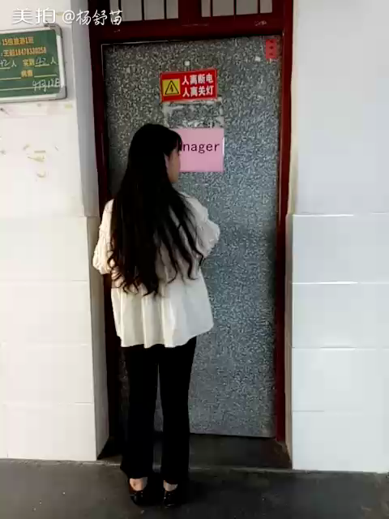
Can Li Xingyu get the job?

Slide 8
succeed!

Slide 9

Listen and repeat
Manager: Take a seat, please.
Peter: Thank you.
Manager: What did you learn at the vocational school?
Peter: I learned pre-school education.
Manager: Do you have any work experience?
Peter: Yes, I’ve worked in a kindergarten for one year.
Manager: OK. We’ll send you a letter if you are admitted.
Peter: Thank you.

Slide 10
Do's and don'ts
rush in
take a seat without being invited
knock at the door and enter the room politely
look sideways
brush your hair with your hand
be calm and confident
pretend to know what you don't know

Slide 11
sit properly
listen carefully
tap your pen on the table

Slide 12
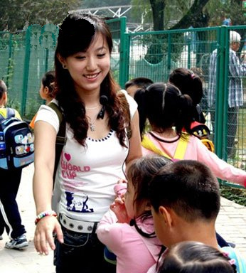
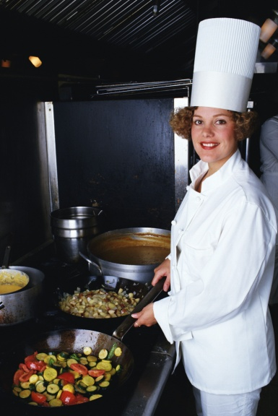

Talk with your partner and give suggestions for hunting such a job.

Slide 13
May you succeed in the future!

